Slide 1
A+ TEAM – GO Final project
HARSH
MOHAMMED ABDUL AKRAM KHAN
MOHAMAD MAHDI ZIAEE
MUKHASIR SHAH SYED

Slide 2
DEMO Hosting Website – google app engine
Google App Engine applications are easy to create, easy to maintain, and easy to scale as your traffic and data storage needs change. With App Engine, there are no servers to maintain. You simply upload your application and it’s ready to go.
App Engine applications automatically scale based on incoming traffic. Load balancing, microservices, authorization, SQL and noSQL databases, memcache, traffic splitting, logging, search, versioning, roll out and roll backs, and security scanning are all supported natively and are highly customizable.
Website served using google app engine and can be access using the link shown in screenshot

Slide 3
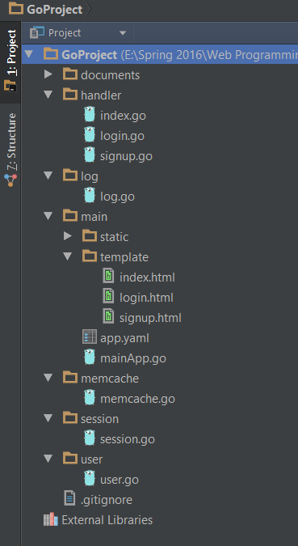
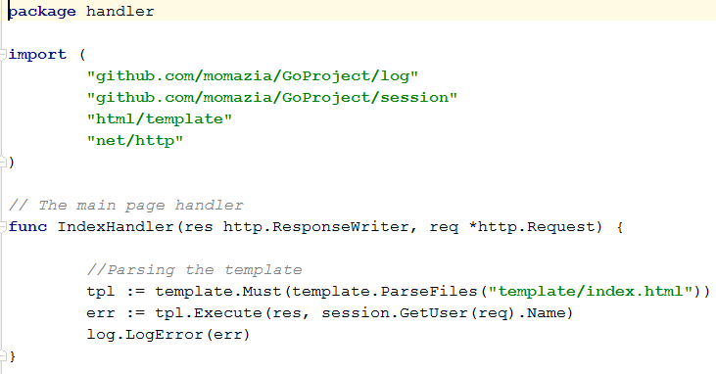
STRUCTURE - HANDLERS

Slide 4
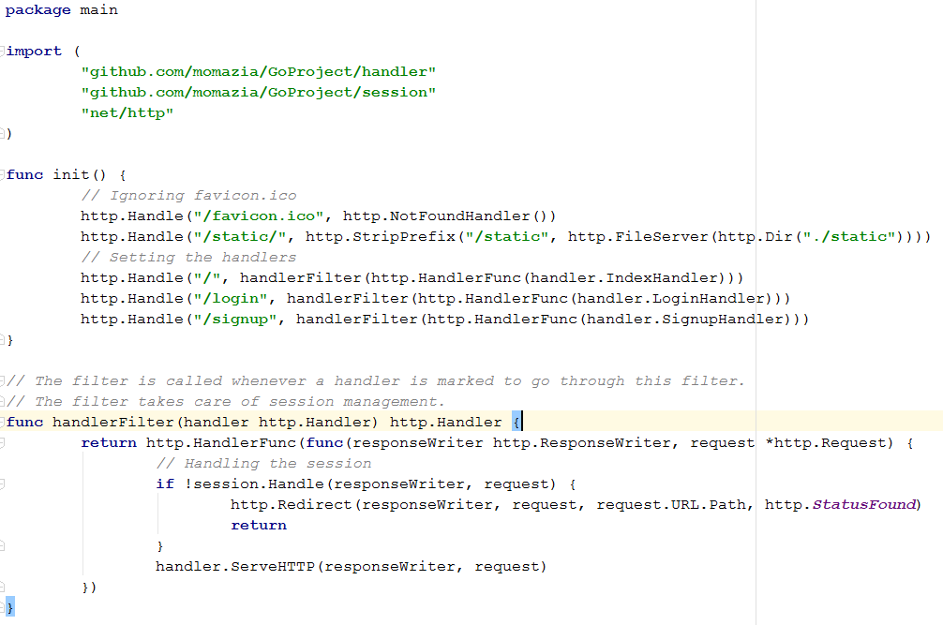
MainApp.go – starting point

Slide 5
Session - COOKIE - UUID
A session is typically, but not always, stateful, meaning that at least one of the communicating parts needs to save information about the session history in order to be able to communicate, as opposed to stateless communication, where the communication consists of independent requests with responses.
BROWSER Session management is particularly useful in a web browser where a user can save all open pages and settings and restore them at a later date. To help recover from a system or application crash, pages and settings can also be restored on next run. Session management is often managed through the application of cookies.
Package UUID is integrated in this project to generate Unique ID’s which could be set as value for the cookie generated on the page. Reference: https://godoc.org/github.com/nu7hatch/gouuid

Slide 6
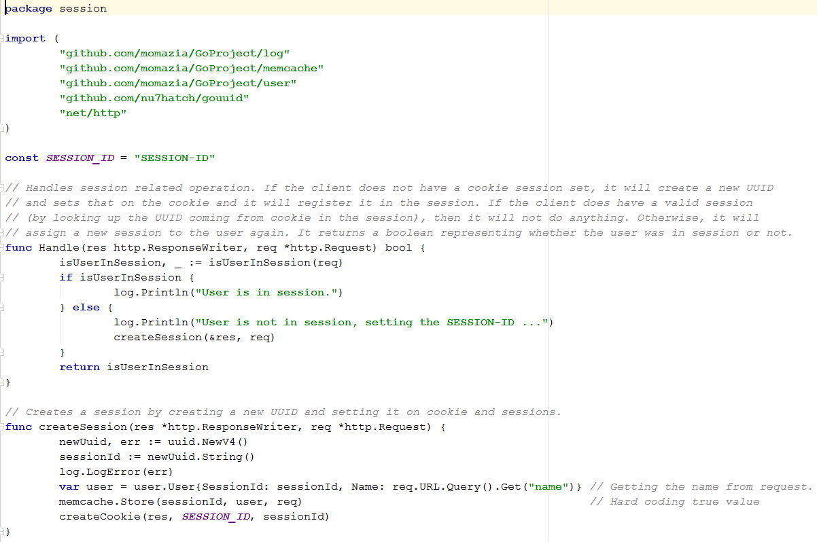
Screenshots

Slide 7
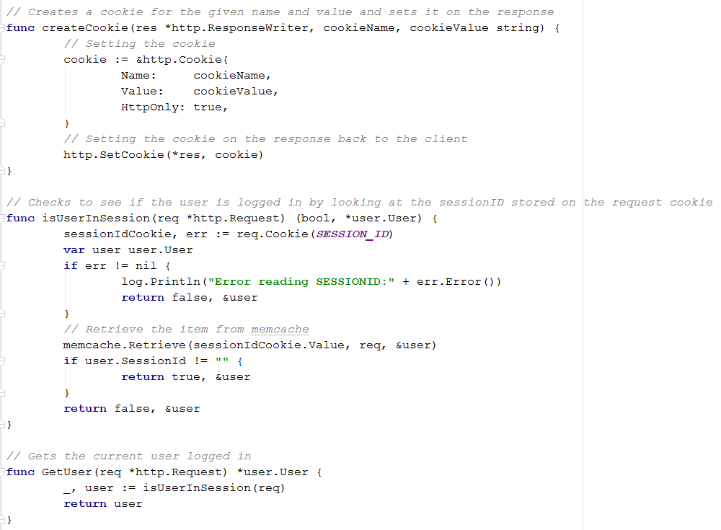

Slide 8
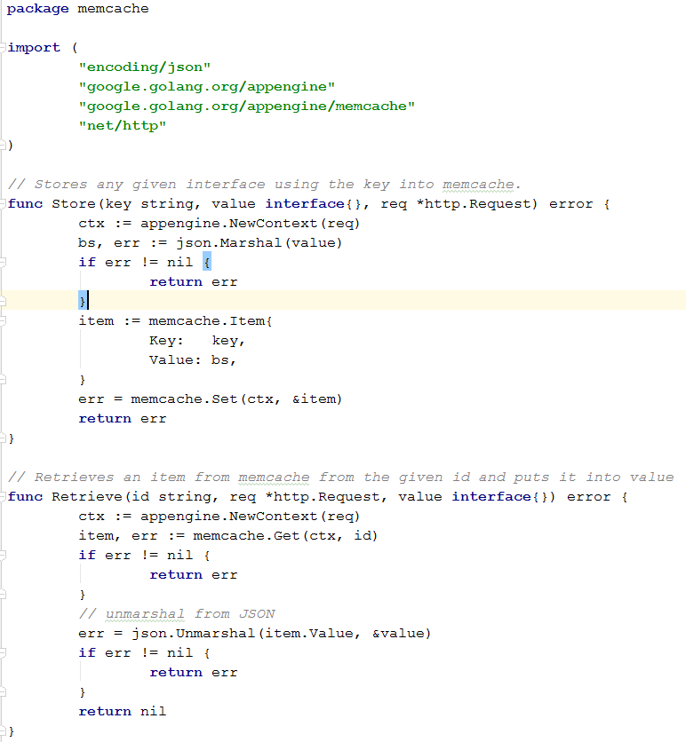
MEMCACHE SCREEN SHOT - CODE

Slide 9
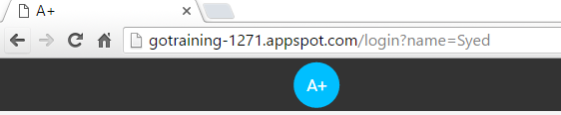
READING VALUE FROM URL – QUERY STRING
A query string is the part of a uniform resource locator (URL) containing data that does not fit conveniently into a hierarchical path structure. The query string commonly includes fields added to a base URI by a web browser or other client application.
We can pass information from page to page in a website.
In this project the query string functionality is used when there is no cookie and user details are picked from the URL for displaying the name (authentication).

Slide 10

THANK YOU

Slide 11

QUESTIONS

